Slide 1
Introduction to Information System Acquisition, Governance and Stakeholders
An Enterprise Perspective
Notes:
Providing an overview of all the things that I had to learn (and learn quickly) as I transitioned from MTF to my current position. This may help you as you transition into your new role or attend enterprise level meetings.

Slide 2
Goals and Objectives
Identify key DoD Stakeholders for Clinical Information Systems.
Recognize the stakeholder organization charts/names of key leaders and influencers.
Recognize critical MHS GENESIS governance and enterprise level management bodies.
Understand the role of capabilities planning in Information System Acquisition.
Recognize the purpose of BCAC/DBS.

Slide 3
Stakeholders, Leadership & Organizational Charts

Slide 4
Goals and Objectives
Identify key DoD Stakeholders for Clinical Information Systems.
Recognize the stakeholder organization charts/names of key leaders and influencers.
Recognize critical MHS GENESIS governance and enterprise level management bodies.
Understand the role of capabilities planning in Information System Acquisition.
Recognize the purpose of BCAC/DBS.

Slide 5
High-Level Overview: Stakeholders
DoD Acquisition Community
DoD Functional and Technical Communities
DHA, Services
Vendor Team
Near future: VA, US Coast Guard
**CONGRESS**
BENEFICIARIES
(& Gen Public)
Notes:
Simply put, these stakeholders are a vital part of the process because they are decision makers, decision influencers, etc.

Slide 6
Deeper Dive DoD Stakeholders
DoD Acquisition Community
USD Acquisition and Sustainment (previously AT&L)
PEO DHMS
DHMSM PMO
DHA Functional Community
USD Personnel and Readiness
ASD Health Affairs
Defense Health Agency Leadership and Directorates
J3 DAD-Healthcare ops and MHS Functional Champion (Clinical and Business functionals)
J6 DAD-Information Office (Technical)
J5 Strategy, Plans and Readiness (previously MHS Functional Champion)
Other J’s
Service Functional, Technical and Healthcare Ops (HCO) Communities
Headquarters, Regions, MTFs

Slide 7
Tri-Service Leadership
Army
USA Surgeon General LTG Nadja West; DSG BG Dingle; DCG HCO MG Clark
MEDCOM HQ: interim CoS Mr. Rich Beauchemin
Army MHS GENESIS Functional Champion and G1/4/6 COL(P) Bagby; G3/5/7 BG Torring; G8/9 Mr. Dan Gall. Army CMIO COL Watkins; Army FAC Executive Mr. Shannon.
Air Force
USAF Surgeon General Lt Gen Dorothy Hogg
Air Force MHS GENESIS Functional Champion: Maj Gen Miller
Air Force CMIO and FAC Exec Col William Baez
Air Force Medical Operations Agency (AFMOA) Brig Gen James Dienst
Air Force Medical Support Agency (AFMSA) support and policy development for TSG, to include IT & acquisition: Col PJ Toth.
Navy
Navy Surgeon General, VADM Forrest Faison
BUMED Executive Director and Navy MHS GENESIS Functional Champion Dr. Malanoski
Navy FAC Executive CAPT Francisco Leal
Deputy Chief of BUMED Readiness and Health: RDML Darin Via
Navy CMIO CDR Hassan Tetteh
Notes:
Army
G1: Human Resources
G4 : Logistics
G6: Health IT (“owns” Clinical Informatics)
G3: Operations
G5: Strategic Plans
G7: Education and Training
G8: Resource Management (includes Business Community)
G9: Facility Planning

Slide 8
Organizational Charts, DHA and Services

Slide 9
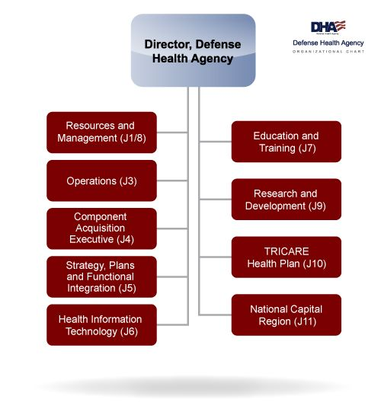

Slide 10
Army
TSG
LTG West
DSG
BG Dingle
MEDCOM CoS
Mr. Beauchemin (interim)
DCG, Operations
MG Clark
G1/4/6
COL/ P Bagby
G3/5/7
BG Torring
G8/9
Mr. Gall (interim)
DCS, Q & S
COL Malish
DCS, Procurement
Mr. Kapec
DCS, PH
Mr. Resta
DCS, Warrior Care & Trans
COL St Laurent

Slide 11
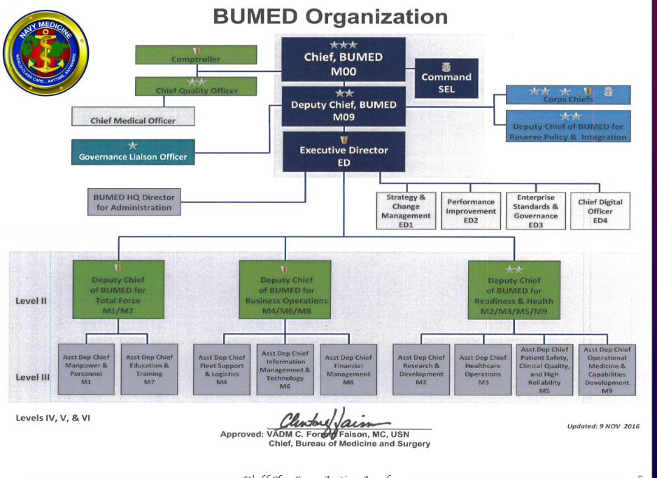

Slide 12
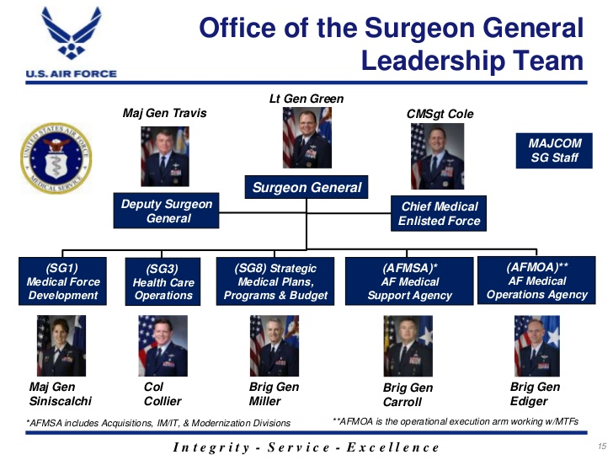
Notes:
**This is an old slide, leaders have changed**
The purpose of this slide is to show org chart USAF Surgeon General Office Leadership

Slide 13
Leadership, Acquisition Community

Slide 14
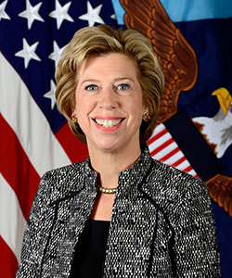
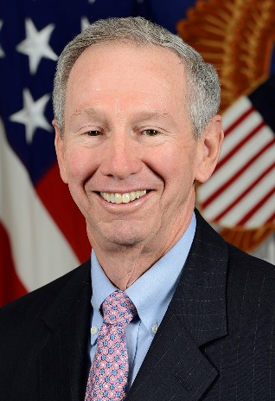
Effective 01 Feb 2018 USD (AT&L) split into two:
Under Secretary of Defense for Acquisition and Sustainment:
HON Ellen M. Lord
Under Secretary of Defense for Research and Engineering:
HON Michael D. Griffin
Notes:
USD (AT&L)= Under Secretary of Defense Acquisition, Technology & Logistics
References
Mehta, Aaron “The Pentagon’s acquisition office is gone. Here’s what the next 120 days bring.” Defense News 01 Feb 18.
https://www.defensenews.com/pentagon/2018/02/01/the-pentagons-acquisition-office-is-gone-heres-what-the-next-120-days-bring/

Slide 15
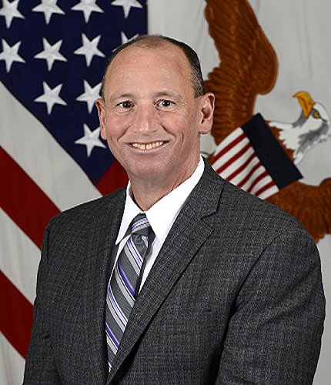
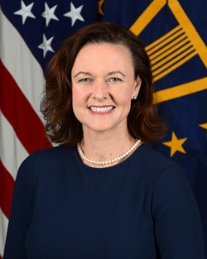
Under Secretary of Defense for Acquisition and Sustainment:
HON Ellen M. Lord
Assistant Secretary of Defense for Acquisition:
HON Kevin Fahey
Program Executive Officer, Defense Healthcare Management System (PEO DHMS)
Ms. Stacy Cummings SES
Notes:
Senior Steering Group is co-chaired by HON Kevin Fahey and Mr. Tom McCaffery (Health Affairs). SSG is the senior DoD body responsible for oversight PEO DHMS. All changes impacting the program (schedule, cost, time, etc) come thru SSG/Configuration Steering Board.

Slide 16

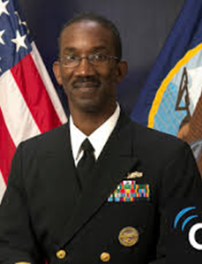
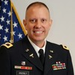
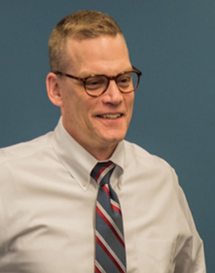
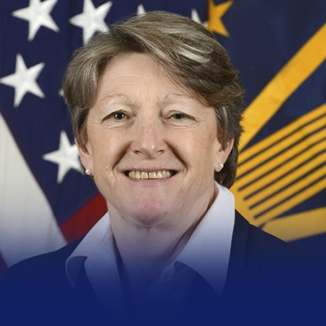
Program Executive Officer, Defense Healthcare Management System: Ms. Stacy Cummings SES
Deputy PEO (Functional) & Deputy PEO (Operations): CAPT James Ellzy
Program Manager, Defense Healthcare Management System Modernization Program Management Office (DHMSM PMO): Mr. Craig Schaeffer
Director, DoD/VA Interagency Program Office: Dr. Lauren Thompson
Acting Program Manager, Joint Operational Medicine Information Systems (JOMIS) Program Management Office: COL Michael Greenly
Notes:
1. There are 3 Programs under PEO DHMS
JOMIS
DHMSM PMO
DoD/VA IPO
2. Two Deputy PEO fall under Ms. Stacy Cummings
a. Deputy PEO- Operations (Previously Mr. Flanders)
b. Deputy PEO- Functional (CAPT Ellzy, aka the PEO DHMS CMIO)
At this time, CAPT Ellzy is responsible for both because Mr. Flanders transitioned to DHA.
Deputy PEO is over several PEO DHMS personnel (to include PEO DHMS CNIO, PEO DHMS Chief Engineer) and over the DHMSM PMO Program Manager. This is to highlight the fact that PEO DHMS has clinical and technical personnel on their team, not just acquisition SMEs.

Slide 17

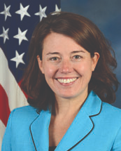
Program Manager, DHMSM PMO: Mr. Craig Schaeffer
Deputy PM, DHMSM PMO: Ms. Aimee Scanlon
APM for Deployment: Cynthia Ellert
APM for EHR: Teresa O’Brien
Operations & Sust: Lance Scott
APM for Testing: Paul Caputo, Cynthia Ellert
Bus Operations: Tim Donnelly
Special Proj: Sandy McIntyre
DMIX: Lance Scot
Notes:
DHMSM PMO has total of 7 offices:
Business ops: Tim Donnelly
Deployment: Cynthia Ellert
EHR: Teresa Obrien, responsible for change management and training.
Testing: Cynthia and Paul
Special Projects: Sandy McIntyre (e.g. rev cycle)
Operations and sustainment: Lance Scott
DMIX: Lance Scott
Not included in this slide are the fact that the following individuals fall under Mr. Schaeffer and Ms. Scanlon:
CDR Alex Holston, DHMSM CMIO
MAJ James Taylor, DHMSM CNIO
Dr. Monica Farah-Stapleton System Engineer, DHMSM PMO
The point of this slide is to show that DHMSM PMO (one of the programs

Slide 18
Leadership, Defense Health Agency

Slide 19
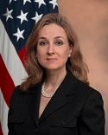
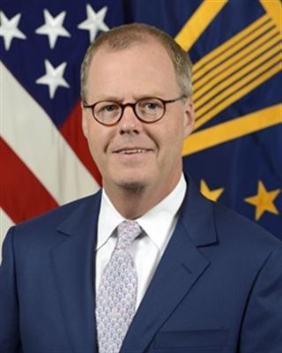
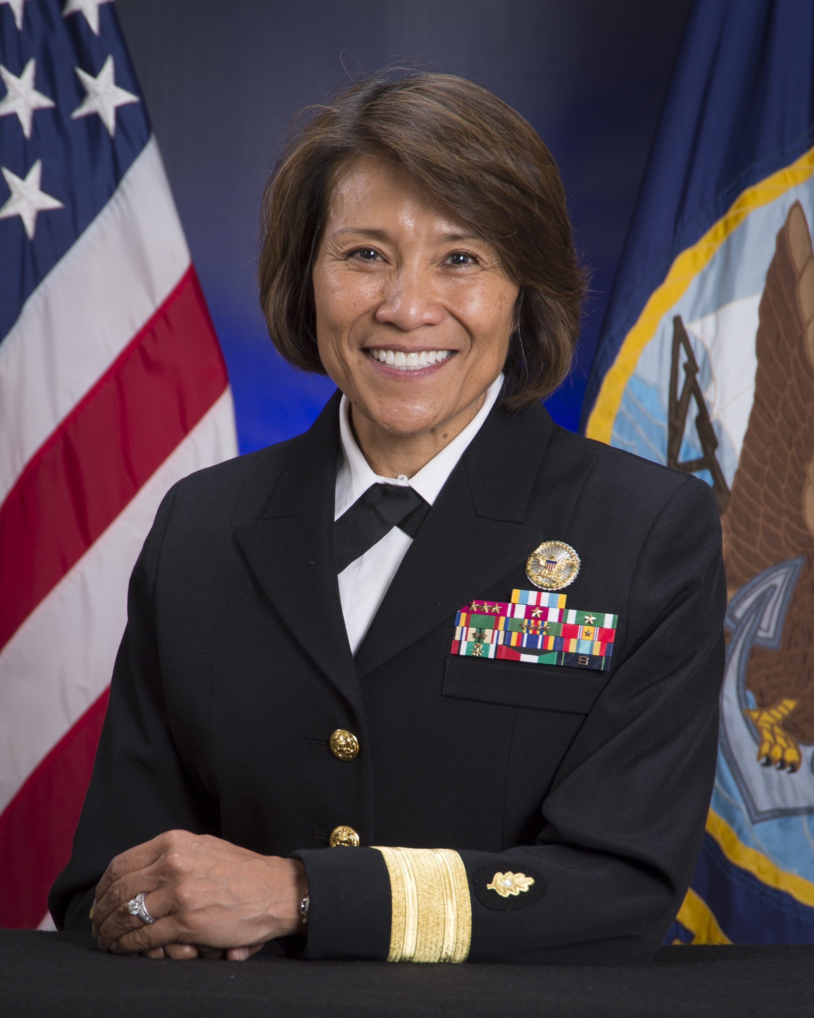
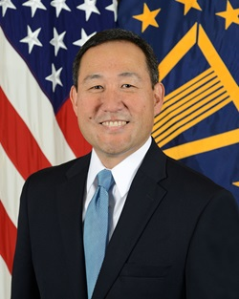
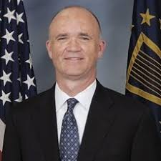
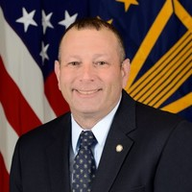
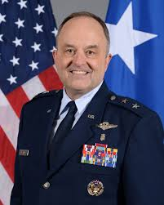

Interim Undersecretary of Defense for Personnel and Readiness: Ms. Stephanie Barna
Assistant Secretary of Defense for Health Affairs: Mr. Tom McCaffery
Director, Defense Health Agency: VADM Raquel “Rocky” Bono
Deputy Director, DHA:
Mr. Guy Kiyokawa
Others
Director, J3 Healthcare Operations and MHS Functional Champion: Maj Gen Lee Payne
J5, Strategy, Plans and Functional Integration: Dr. Paul Cordts SES
Chief Information Officer J6 Health IT: Mr. Pat Flanders SES
Chief Health Information Officer: Col Tom Cantilina

Slide 20
MHS GENESIS Governance & Enterprise Level Management

Slide 21
Goals and Objectives
Identify key DoD Stakeholders for Clinical Information Systems.
Recognize the stakeholder organization charts/names of key leaders and influencers.
Recognize critical MHS GENESIS governance and enterprise level management bodies.
Understand the role of capabilities planning in Information System Acquisition.
Recognize the purpose of BCAC/DBS.

Slide 22
Old Governance Structure
BPM WG – Business Process Management WG
MDWG- Medical Device Working Group
CMWG- Change Management Working Group
HIE WG – Health Information Exchange WG
DDWG- Design Decision Working Group
TSWAG – Tri-Service Workflow Advisory Group
TFWG- Theater Functional Working Group
Medical Deputies Action Group (MDAG)
USD
AT&L
HIT, DHA
Functional Champions Leadership Group* (FCLG)
eMSM Leadership Group
Medical Operations Group (MOG)
Medical Business Operations Group (MBOG)
Manpower and Personnel Operations Group (MPOG)
DHMS PEO
DHMSM
IPO
JOMIS
Functional Advisory Council (FAC)
Clinical Portfolio Management Board (CPMB)
Readiness & Force Support Portfolio Management Board (R&FSPMB)
Business Portfolio Management Board (BPMB)
EHR
contractor
HIE WG
BPM WG
FC Leadership Group:
Chair: Dr. Paul Cordts (SES)
Army: BG Stephens
Air Force: Maj Gen Roosevelt Allen
Navy: Dr Malanoski (SES)
MDWG
TFWG
TSWAGs
DDWG
CMWG
Sanctioned tri-service working groups
FAC Exec
Army: COL Nieves (interim)
Air Force: Col Will Baez
Navy: CAPT Francisco Leal
DHA: CAPT Karen Mathews - Chair
TSWAGs: 19 groups aligned to Cerner EHR.
300+ Army SMEs working standardization of business and clinical processes
Work started March 2015, TSWAGs are ongoing
DDWG: Make high level/enterprise design decisions. Army reps: 1 MD, 1 RN, 1 PAD, 1 Quality/Safety
Notes:
This MHG GENESIS governance structure is old (from late 2017 after Ms. Wolford-Connors retired), changed in Jan 2018
Notice the relationship between working groups and FAC; FCLG and FAC; and FCLG to DHA and DHMS PEO
Under the new Governance structure (next slide):
-FCLG has joined MOG (they meet as a group every other week).
-OCHIO has the responsibility for “functional oversight” (which includes governance that was previously a FAC responsibility and resolving issues thru “OCHIO solution owners” that have effectively “replaced” the working groups previously chartered under the FAC).
*OCHIO mixes management and governance even though it is supposed to only be a management body (ongoing discussion)- this is due to dual hatted nature of Deputy CHIO. FAC meets with OCHIO on a weekly basis, to help inform governance efforts.
-01 OCT 18 OCHIO will be officially instituted into DHA under J3. It is unofficially divided between J3 and J5 at present.
-no official TDA positions in OCHIO yet.

Slide 23
MHS Governance (in transition)
SSG/CSB
USD-AT&L
ASDHA
$
Director
DHA
★
PEO DHMS
DHMSM PMO
ADHCA
★
★
ESB (MOG)
DAD-IO
DAD-HCO
DAD-MA
DAD-FO
★
★
MOG/FCLG
Fxnl Champion
DMOG
FAC
HROM
Chief Health Informatics Office
(CHIO)
 | SSG: Any ‘Major’ Changes in contract scope/milestones and/or funding for MHS GENESIS are discussed at SSG. USD AT&L and ASD HA co-chair the CSB, the approving body.
 | GENESIS Coordination of Execution
CCAC
$
Content & configuration
End user engagement
Enterprise Engagement
Enhancements & Requirements
Clinical Communities
★
TSWAGs
Notes:
This Governance structure is in transition and is correct as of June 2018.
*ADHCA: Assistant Director – Healthcare Administration
*CCAC: Clinical Community Advisory Council
*CSB: Configuration Steering Board (approving body)
*DAD-FO: Deputy Assistant Director – Financial Operations
*DAD-HCO: Deputy Assistant Director – Healthcare Operations
*DAD-IO: Deputy Assistant Director – Information Operations
*DAD-MA: Deputy Assistant Director – Medical Affairs
*DHMSM PMO: Defense Health Management Systems Modernization Program Management Office
*DMOG: Deputy Medical Operations Group
*ESB: Enterprise Services Board
*FAC: Functional Advisory Council (O6 Level Board)
*HROM: High Reliability Operating Model
*MOG/FCLG: Medical Operations Group/Functional Champion Leadership Group– combined approx January 2018.
*OCHIO: Office of the Chief Health Information Officer (DHA) -- Chief Health Information Office is the new industry name for Chief Medical Informatics Officer (CMIO)
*PEO DHMS: Program Executive Office Defense Health Management Systems
*TSWAGs: Tri-Service Workflow Advisory Groups

Slide 24
MHS GENESIS Management

Slide 25
Relationship between OCHIO, Services and ISC
CHIO
Col Thomas Cantilina
Service CMIOs
MHS
End User Engagement (OCM)
15 MAR 2018
Data Coordination
(Future)
Content & Configuration
15 MAR 2018
Enhancements /
Requirements
(Near Future)
Enterprise Engagement
15 MAR 2018
Issue Resolution
Training/Roles Coordination
Region
Informatics Steering Committee
MTFs
Site Integrator
15 MAY 2018
Training/Roles Manager
15 MAY 2018
Clinical Operations
Admin/Business
Notes:
Current OCHIO construct.
Service CMIO /FAC executives meet with OCHIO on a weekly basis.

Slide 26
DHA Office of the Chief Health Information Officer
HCO
Office of the CHIO
Col Thomas Cantilina
Service CMIOs
J6 SDD
Training
^{S&A Board}
HROM
DHMSM Issue (Trbl Tkt) Resolution
End User Engagement
CDR Karen Matthews
Content & Configuration
Col Thomas Cantilina
DHMSM
MHS Engagement
COL Jacob Aaronson
Clinical Communities
DHMSM Training
Issue Resolution
Training Coordination
Working Groups
Solution Owners
Define Clinical Process
Documentation
Dentrix
Forms Management
FirstNet
PowerPlans and Orders
Pathology/Laboratory/Radiology (PLX)
Reports
PowerChart Ambulatory
Rules and Alerts
PowerChart Impatient
RevCycle
SurgiNet
Notes:
Overview of DHA’s Office of the Chief Health Information Officer (OCHIO).
Currently, OCHIO is only responsible for MHS GENESIS functional oversight (eventually, OCHIO will be responsible for Legacy systems as well- Date TBD).
_______________________
S&A Board- MHS GENESIS Sustainment and Adoption Board, an MHS GENESIS functional issue adjudication board.
Functional issues (e.g. content or configuration issue) are researched and reviewed by the MTF’s Informatics Steering Committee (ISC) and OCHIO “Solution owner” team before being presented at S&A Board.

Slide 27
Intro to Key Information System Acquisition Concepts

Slide 28
Goals and Objectives
Identify key DoD Stakeholders for Clinical Information Systems.
Recognize the stakeholder organization charts/names of key leaders and influencers.
Recognize critical MHS GENESIS governance and enterprise level management bodies.
Understand the role of capabilities planning in Information System Acquisition.
Recognize the purpose of BCAC/DBS.

Slide 29
Capability Planning

Slide 30
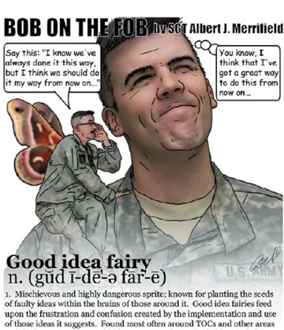
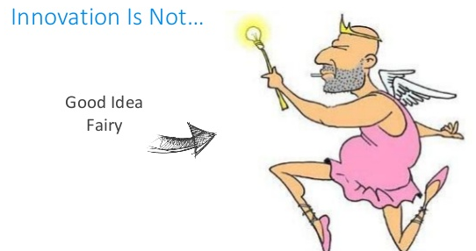
Notes:
Capability planning encourages innovation and adoption of required capabilities where appropriate while reducing waste (costs, inefficiencies, etc).

Slide 31
Capability Planning
Short definition:
The process used to identify capability gaps and determine the best way to close them.
Longer definition:
Disciplined approach that helps us identify current & future requirements and recommend “materiel” or “non-materiel” solutions to address them.
DOTML-PF (a.k.a. DOTmLPF-P)
For instance, do we need new software, training or a change in policy to meet the requirements?
Notes:
Capability: ability to execute a specified course of action (e.g. ability to download and review a radiology image for diagnostic purposes).
Term is also used for solutions that help us meet these requirements.
___________________________________
DOTmLPF-P (Reference: https://www.dau.mil/acquipedia/Pages/ArticleDetails.aspx?aid=d11b6afa-a16e-43cc-b3bb-ff8c9eb3e6f2)
- Doctrine: the way we fight (e.g., emphasizing maneuver warfare, combined air-ground campaigns) - Organization: how we organize to fight (e.g., divisions, air wings, Marine-Air Ground Task Forces) - Training: how we prepare to fight tactically (basic training to advanced individual training, unit training, joint exercises, etc). - materiel: all the “stuff” necessary to equip our forces that DOES NOT require a new development effort (weapons, spares, test sets, etc that are “off the shelf” both commercially and within the government) - Leadership and education: how we prepare our leaders to lead the fight (squad leader to 4-star general/admiral - professional development) - Personnel: availability of qualified people for peacetime, wartime, and various contingency operations - Facilities: real property, installations, and industrial facilities (e.g., government owned ammunition production facilities) - Policy: DoD, interagency, or international policy that impacts the other seven non-materiel elements.

Slide 32
Capabilities Based Assessment (CBA) Needs vs. Gaps
The overarching framework used in Capability Planning.
CBA:
Identifies what needs to be done then compares that to our current capabilities.
Gaps identified during this process will become the “required capabilities”.
Recommends potential ways to fill the gap(s).
Helps us figure out if we can fill the gap(s) without buying a new system (non-materiel solutions) or not.
Notes:
Non-materiel solutions are usually faster to implement and much less expensive than materiel solutions (in this case Information Systems).

Slide 33
High-level overview of CBA
Compare what we need to do in the future vs.
What we can do today
to identify
Capability Gaps
Can a non-materiel solution fill the gap?
Recommend
Potential
Solutions

Slide 34
Capabilities Based Assessment (CBA)
Based on JCIDS methodology. JCIDS methodology involves the following steps:
Capabilities Based Assessment
Documentation of Capability Needs
Review, Validation and Approval
CBA is the analytic basis of the JCIDS process.
The 8 step CBA process is outlined in JCIDS Manual.
Notes:
Joint Capabilities Integration and Development System (JCIDS): 1 of 3 decision support systems used for capability planning. JCIDS, Defense Acquisition System (DAS) and Planning, Programming, Budgeting, and Execution (PPBE) Process undergird Capability Planning.
-According to DAU, “JCIDS, DAS and PPBE systems must work together for the development of effective systems for the war fighting users. ”

Slide 35
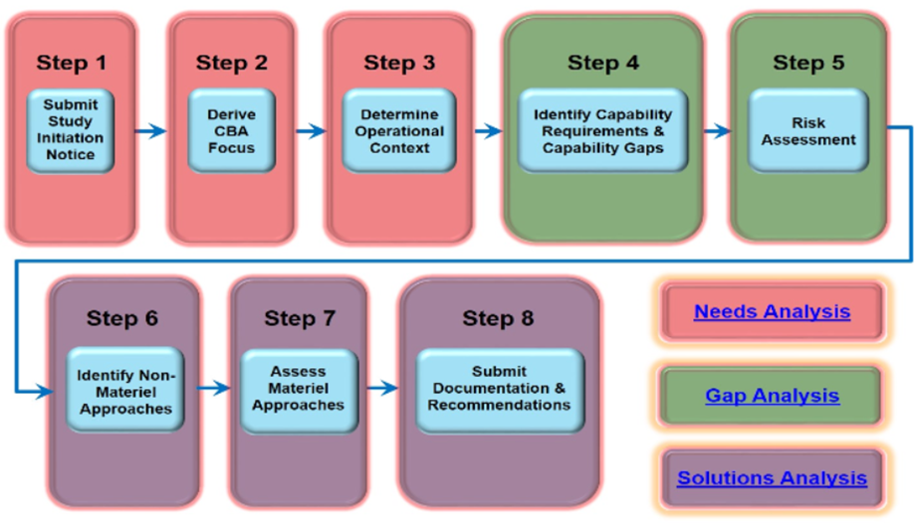
Overview of the 8 step CBA process
Notes:
Needs analysis (steps 1-3) identify the problem that needs to be assessed, concepts to be examined, timeframe in which the problem is being assessed, and the scope of the assessment.
Gap analysis (steps 4-5) identify the capability requirements and any associated capability gaps or redundancies. Also, assess the potential risks associated with each capability gap and set the stage for Steps 6-7.
Solutions Analysis (steps 6-8)
In Step 6, we determine if a non-materiel approach can wholly or partially mitigate any of the capability gaps by recommending changes to existing capabilities in one or more of the non-materiel (DOTmLPF-P) and we assess the non-materiel approach.
Step 7 assesses general approaches for materiel capability solutions which can wholly or partially mitigate any of the capability gaps.
Step 8 offer recommendations for the most appropriate approach(es) to close or mitigate capability gaps and reduce operational risk.

Slide 36
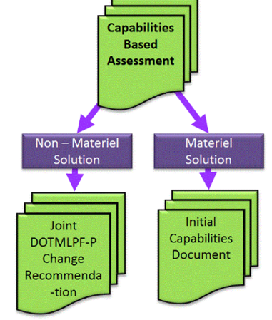
Documenting Results of CBA Materiel vs. Non-Materiel Solutions
Notes:
1. DOTMLPF-P Change Recommendation (DCR) is submitted for validation in JCIDS if a new non-materiel solution is the way to go.
2. If it’s not clear that a non-materiel solution will solve the problem and a materiel approach is needed, or a combination of non-materiel and materiel approaches are needed, generate a validated Initial Capabilities Document (ICD) to support follow-on analytical efforts, such as an analysis of alternatives or AoA.
3. If capability solutions do not exist in the Joint force, but the sponsor is willing to accept risk, then no JCIDS document is generated.
Notes:
An ICD is not always required before creating successor documents – CDDs, CPDs, or Joint DCRs – if alternative studies or documentation source make the ICD redundant. In cases where the Sponsor proposes to proceed directly to a successor document, the general content of the ICD, including capability requirement and capability gap tables, will be provided in the successor document.
Information System (IS) ICDs: are a variant of ICDs that facilitates development/acquisition of IT systems and reduces administrative delays by placing specific boundaries.

Slide 37
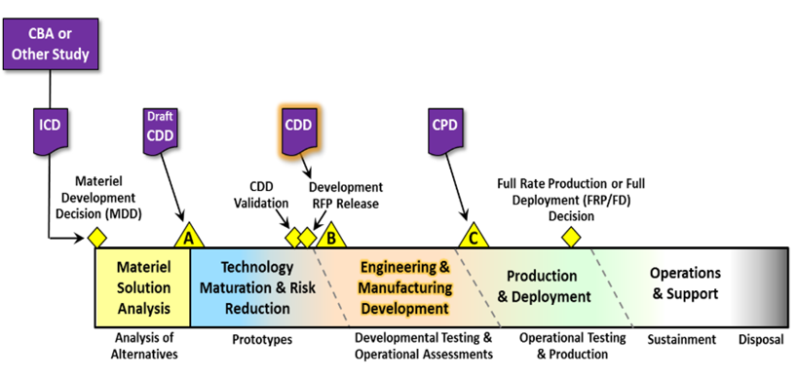
Documentation of Capabilities: from ICD to RFP
Notes:
We build upon the ICD by documenting a formal program need in the Capability Development Document (CDD).
The CDD builds on the ICD and captures the information necessary to develop a proposed program.
The CDD focuses on design and development, provides an overview of all increments
CDD provides Key Performance Parameters (KPPs), Key System Attributes (KSAs), and additional operational performance attributes
2. A validated CDD is used to inform the Request for Proposal (RFP).
RFP: A solicitation used in negotiated acquisition to communicate government requirements to prospective contractor and to solicit proposals.
3. The CDD is refined into a Capability Production Document (CPD) once the program nears the end of development for each increment.
CPD focuses on production and a specific increment. KPPs noted in CPD have been refined and tailored to the production system.

Slide 38
Intro Business Capability Acquisition Planning & Defense Business Systems

Slide 39
Business Capability Acquisition Cycle (BCAC)
“Traditional” acquisition processes (e.g. weapons system acquisition) may not be agile enough to keep up with the Defense Business System (DBS) information technology capabilities being introduced to the market.
Business System Requirements and Acquisition assigns a unique governance to define the requirements and the use of tailored acquisition models and establishes the Business Capability Acquisition Cycle (BCAC).
Notes:
DBS acquisition places considerable emphasis on analysis, critical thinking, requirements development and refinement, and scoping. This is led by the Functional Sponsor.
The Functional Sponsor and Milestone Decision Authority (MDA) can decide to invest time and resources into investigating business solutions so that they can establish a clear understanding of the “business” capabilities that are needed.
Reference: DODI 5000.75 Business System Requirements and Acquisition/ DBS.
http://www.esd.whs.mil/DD/

Slide 40
Defense Business System (DBS)
Definition: An information system used to support business activities, such as contracting and pay/personnel management systems.
National Security Systems do not fall under this category.
DBS Governance Process: DBS has its own capability planning governance process. The key people in the governance process include DBC, DAB, Steering Board.
Real world example
MHS GENESIS DAB is SSG/CSB
MHS GENESIS functional sponsor is Health Affairs
MHS GENESIS component acquisition executive is AT&L
MHS GENESIS steering board: AT&L and HA co-chair SSG
Notes:
DBS Governance Process DBS has its own capability planning governance process. The key people in the governance process include
Defense Business Council (DBC). The DBC provides advice to the Secretary of Defense on developing the Business Enterprise Architecture (BEA), reengineering the Department’s business processes, developing and deploying business systems, and developing requirements for business systems. It is the requirements validation authority for business systems.
Defense Acquisition Board (DAB). The DAB provides advice to the Defense Acquisition Executive (DAE) or designee on critical decisions concerning acquisition programs.
Configuration Steering Board. A steering board will be established for each program to adjudicate unresolved issues between the functional and acquisition communities involving potential customization or process changes.
The steering board will consider development cost, schedule implications, and impacts to sustainment in its decision processes. Steering board membership will include the functional sponsor (co-chair), Component Acquisition Executive (CAE) or designee (co-chair), and resource sponsors.
__________________________

Slide 41
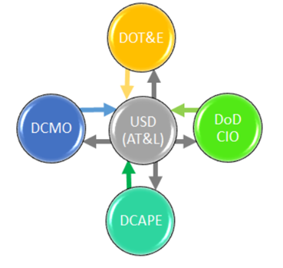
Defense Business System Governance
Notes:
USD (AT&L) changed to A&S: HON Ellen Lord
DOT&E Director, Operational Test and Evaluation: Mr. Robert F. Behler
DoD CIO Chief Information Officer: Mr. Dana Deasy
D-CAPE Director, Cost Assessment and Program Evaluation: Mr. Robert Daigle (provides independent analysis and advice to DoD officials on matters of cost estimation and cost analysis for weapons acquisition programs, including matters of program life-cycle cost)
DCMO Deputy Chief Management Officer (became CMO in 2018): Mr. John Gibson II (advises on matters related to management and improvement of defense business operations).

Slide 42
DBS Capabilities Requirements
Chief Management Officer with support from the Functional Sponsor approves the Capability Requirements.
Capability Requirements must include:
A description of the business problem or opportunity and its impact on cost and mission performance;
Prioritized business capabilities and their attributes;
Capability performance measures and associated current and future values, including threshold and objective values for future capability performance; and
Relevant Laws, Regulations, and Policies
Notes:
DBS does not follow the JCIDS process, unless special interest by Joint Requirements Oversight Council (JROC)

Slide 43
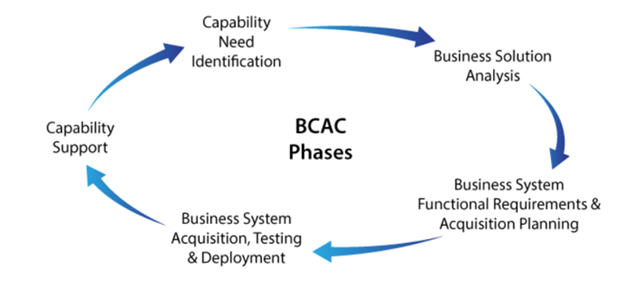
Notes:
Capability Need Identification phase: establish a clear understanding of needed business capabilities.
Business Solution Analysis: determine the high-level business processes supporting the future capabilities.
Business System Functional Requirements and Acquisition Planning: establish the acquisition strategy that will support functional requirements.
Business System Acquisition, Testing and Deployment: achieve organizational change through business process changes and delivery of the supporting business system, with minimal customization.
Capability Support : provide enduring support for the capability established by the business system.

Slide 44
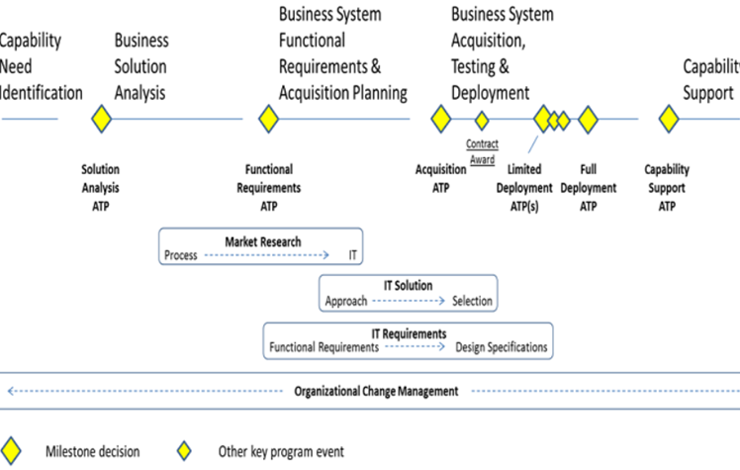
Lifecycle overview: BCAC
Notes:
ATP- authority to proceed

Slide 45
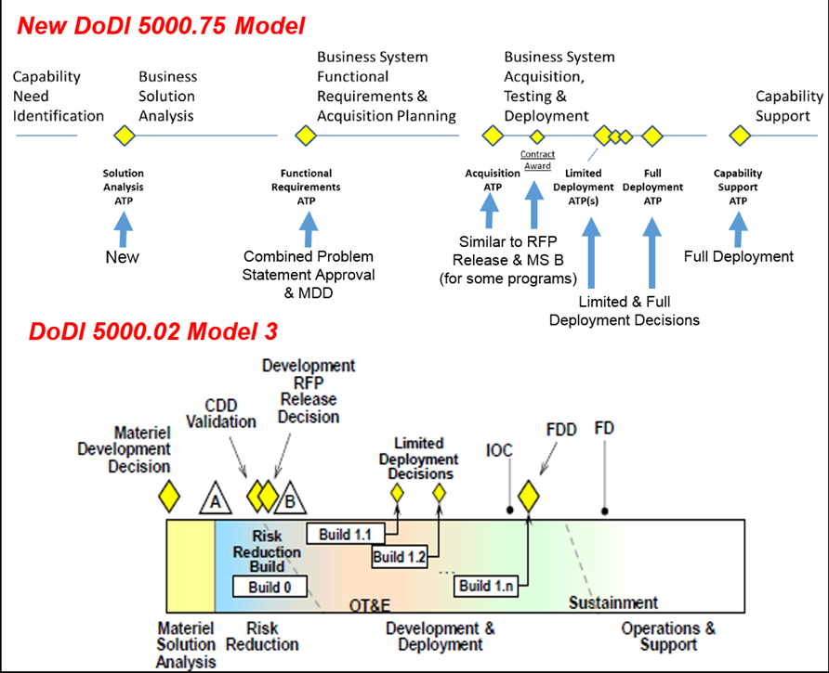
Notes:
Side by side comparison of models for BCAC and traditional information system (e.g. weapons system) acquisition cycle.

